Slide 1


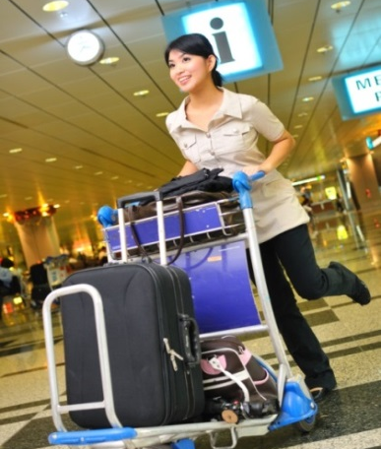



Manage and execute a detailed tour itinerary
D2.TTO.CL4.09
Notes:
Trainer welcomes students to class.

Slide 2
Manage and execute a detailed tour itinerary
Introduction
Trainer
What are we going to cover?
Unit requirements
Notes:
Session introduction
Trainer to greet the trainees and introduce himself or herself
Explain the unit is looking at the skills and knowledge required to manage and execute a detailed tour itinerary
Explain to the trainees they are expected to actively participate in the learning process : from giving examples to complete research and participate during class work and activities

Slide 3
Manage and execute a detailed tour itinerary
Prepare for tour itinerary
Conduct departure-related activities
This unit has 7 elements
Brief tour staff
Liaise with external industry colleagues throughout the tour
continued
Notes:
Trainer to list all elements, explain to the trainees some topics, contents will be common to a few elements.
Clarify that the unit addresses the management practices underpinning the on tour activities the tour leaders/guides will undertake and does not address the leading of the tour

Slide 4
Manage and execute a detailed tour itinerary
Manage on tour itinerary
This unit has 7 elements
Deal with unexpected events
Finalise the tour
Notes:
Trainer to make clear that the elements follow the order in which tour management and execution takes place

Slide 5

Element 1 Prepare for tour itinerary
Identify the requirements in the itinerary
Clarify requirements relating to the itinerary
Plan tour in accordance with briefing information
Identify tour related risks
Develop contingency plans for risks
Confirm reserved tour components
Notes:
Each of the 5 specific criteria details recommended steps for the preparation of a tour itinerary

Slide 6
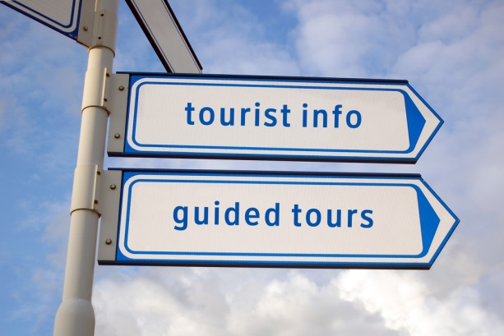
1.1 Identify the requirements in the itinerary
What is an itinerary?
It is the road map for a tour including:
Tour route
All travel arrangements by date and order delivery
Notes:
Trainer to clearly explain what an itinerary is and its importance as the ‘data base’ , framework for the tour including all the information necessary to organise the tour.
Tour route means : where is the tour going?
ALL travel arrangements means : every aspect of the tour from transport to accommodation, meals, activities etc..

Slide 7

1.1 Identify the requirements in the itinerary
The itinerary include all products, services, activities required during the trip:
Destination: domestic-international
Dates and times
Type of transport/s
Transfers if applicable
Accommodation and Meals
All tour activities from visits to options and free time
Notes:
Clearly identifying ALL requirements needs to take place to make sure the tour can be delivered in an efficient and successful manner
Every step of the itinerary needs to be listed with as much information as is available at this preparation time
Trainer to organise the trainees in small 5 groups and ask each group to identify the products, services and activities that will be required for the following tours :
Day city tour
Galleries, museums day tour
One day reef tour
Overnight bush camping tour
2 days cruise

Slide 8

1.1 Identify the requirements in the itinerary
The itinerary include all products, services, activities required during the trip:
Bookings information:
Customers details
Payments
Notes:
Trainer to insist on the importance of
Knowing who your customers are so you, as the tour guide, are aware of the group profile: younger, older, families for example. This will help you understand the group profile and understand better the tour group members needs and expectations
Payments also need to be recorded and checked
If some destinations , activities have had to be changed , you need to know
Clarification on all products and services scheduled to be part of the tour need to be take place and it is paramount to have all suppliers contact details on hand at any time during the tour

Slide 9

1.1 Identify the requirements in the itinerary
The itinerary include all products, services, activities required during the trip:
Recent changes to advertised:
Destinations, activities, experiences
Notes:
Any changes to destinations, activities and experiences need to be taken into account. Those changes might be due to seasonal changes, one off event such as an exhibition
Trainer to ask trainees to research on the internet, in their country, region, specific events, exhibition, shows that they think could be included in tours while they take place

Slide 10

1.2 Clarify requirements relating to the itinerary
Financial requirements and compliance with organisation terms and conditions
Finalise customers preferences
Notes:
Trainer to list the requirements and divide the class in small working groups
Trainees to research publicised financial terms and conditions for different tour organisations and discuss why they think why it is important
Trainer to insist on to importance of finalising customers preferences prior to the beginning of the tour. Knowing which activities, options they have chosen is important to confirm numbers to the suppliers of products and services

Slide 11

1.2 Clarify requirements relating to the itinerary
Follow up on potential customers having failed to:
Confirm their participation
Pay for the tour
Notes:
Trainer to explain that this stage is about contacting potential customers who are on file as having contacted the organisation in regards to the tour but have not followed up on
Confirming if they are still interested in participating to the tour
Obtaining payment if applicable
This will finalise the number of participants. It is also an important part of customer service delivery as some potential customer might simply have forgotten to send payment

Slide 12

1.3 Plan in accordance with briefing information
Advise all the existing suppliers with the information they need to deliver the required products and services
Notes:
Trainer to remind trainees of the importance of the ‘preparation work’ and how all the information collected will now be used to plan the tour.
Trainer to explain that we are now at the planning stage of the tour using the information we have on hand
The first step is to contact all suppliers to confirm the delivery of products and services for the tour:
Transport-Accommodation-Catering and all activities included in the tour
Trainer to explain that timeline is important to give suppliers enough time to get organised to deliver the products, services they are contracted for with the organisation

Slide 13

1.3 Plan in accordance with briefing information
Seek information from those suppliers in regards to specific tour requirements
Notes:
Using the examples from the workbook or its/her own, the trainer illustrates when, why you would seek information in regards to
Accommodation
Catering
Specific equipment

Slide 14

1.3 Plan in accordance with briefing information
Sourcing and contracting new suppliers if required
Notes:
Trainer explain that sometimes the organisation will need to source and contract new suppliers. This business process is time consuming and reinforces the importance of having as much tour specific information as early as possible
Using the examples from the workbook or its, her own trainer to illustrate the point just made

Slide 15

1.3 Plan in accordance with briefing information
Manage all reservations:
Making bookings
Check all inclusions
Liaise with handling agents, if applicable
Notes:
Trainer to clarify that all reservations includes all products and services part of the tour
Prior to the beginning of the tour, inclusions must all be checked to make sure they can take place: some places might be closed for winter, summer, renovations. You must always make sure you have the latest information on hand and a handling agent, on the ground, will help with this. Trainer to remind trainees of what a handling agent : your organisation representative on the ground

Slide 16

1.3 Plan in accordance with briefing information
Manage tour content can cover:
Carriers
Destinations
Activities
Specific inclusions
Notes:
Trainer to ask the trainees to give one example for each of the listed tour content components and share with the rest of the class

Slide 17


1.3 Plan in accordance with briefing information
Manage customers’ needs and expectations:
Importance
What would be your expectations?
Notes:
Trainer to insist on the importance of managing customers’ needs and expectations to make sure the tour meets the group members needs and expectations from beginning to end
Trainees to reflect on what expectations they would have if they were doing a educational day tour, visiting one museum and one art gallery. Trainer to write all the board the answers and discuss them with the group

Slide 18

1.4 Identify tour-related risks
Safety and security are an important of tour management and the organisation has a duty of care towards its customers and staff:
External risks factors
Tour specific risks factors
Notes:
Trainer to remind trainees of what Duty of Care is and clarify that the safety and security requirements for a tour will be different according to the country the tour takes place, and the type and length of the tour
Trainer to explain how it is almost impossible to forecast every risk

Slide 19

1.4 Identify tour-related risks
Safety and security are an important of tour management and the organisation has a duty of care towards its customers and staff:
External risks factors:
Political factors
Theft
Environmental conditions
Notes:
Trainer to explain how some risk are more ‘serious’ that others, present more danger and ask the trainees to rate the 3 risks on from 1 : highest risk to 3 lowest risk. Trainees to share and explain their ranking

Slide 20

1.4 Identify tour-related risks
Safety and security are an important of tour management and the organisation has a duty of care towards its customers and staff:
Tour specific risks factors:
Infrastructures
Access
Tour activities
Notes:
Tour specific risks factors need to be closely monitored to ensure the safety and security of all tour group and cover all aspects, inclusions of the tour.
Using the workbook as a guide, the trainer can again split the group into 5 small groups and allocate one of the 5 topics on the 2 slides to investigate. The tour is an overnight bush tour
Trainees to share the identified risk with the rest of the class and trainer to reinforce the importance of risk management

Slide 21

1.4 Identify tour-related risks
Safety and security are an important of tour management and the organisation has a duty of care towards its customers and staff:
Time management
Group profile
Notes:
Tour specific risks factors need to be closely monitored to ensure the safety and security of all tour group and cover all aspects, inclusions of the tour.
Using the workbook as a guide, the trainer can again split the group into 5 small groups and allocate one of the 5 topics on the 2 slides to investigate. The tour is an overnight bush tour
Trainees to share the identified risk with the rest of the class and trainer to reinforce the importance of risk management

Slide 22

1.4 Identify tour-related risks
Safety and security are an important of tour management and the organisation has a duty of care towards its customers and staff:
Potential service delivery difficulty
Notes:
Brainstorming activity :
When
Why when would potential service delivery difficulties happen?

Slide 23
1.5 Develop contingency plans for risks
Contingency plans are part of the organisation Risk Management Plan
Each identified risk needs to be matched with a contingency plan
Notes:
Trainer to clarify where contingency plans fit with the organisation RMP

Slide 24
1.5 Develop contingency plans for risks
Contingency plans are part of the organisation Risk Management Plan.
Risk identification
Risk management steps
Risk review
Risk assessment
Risk control
Notes:
Trainer to briefly go through those 4 steps and explain that we will mainly look at 1, 2 and 3 in this unit

Slide 25

1.5 Develop contingency plans for risks
Workbook table activity
Notes:
Trainer and trainees to consult the table with the risk identified + proposed contingency plans and discuss if other contingency plans would be applicable for some of the risks identified

Slide 26

1.6 Confirm reserved tour components
The last step in the preparation for tour itinerary is to make sure all components are reserved prior to the commencement of the tour:
Information distribution to all concerned suppliers:
Group tour members details
Booking confirmation numbers
Notes:
Trainer to explain that distributing the correct information is paramount to the successful delivery of the tour.
Suppliers need to know participants numbers, in regards to transport and accommodation, their names.
The group profile information : age, gender, interest will also ensure the service will be more customised to the tour group members
Booking numbers are a way of confirming that services are reserved

Slide 27

1.6 Confirm reserved tour components
The last step in the preparation for tour itinerary is to make sure all components are reserved prior to the commencement of the tour:
Information distribution to all concerned suppliers:
Specific travel requirements
Payments
Notes:
Official travel requirements such as visa, passport, vaccinations need to be checked and passed onto the relevant body
Of course, payments need to be processed so that the tour products and services can be delivered
Working in pairs, trainees to match the information to the relevant body, supplier
Passport number
Customer request for a quiet room
Organisation records
Accommodation venue

Slide 28

1.6 Confirm reserved tour components
The last step in the preparation for tour itinerary is to make sure all components are reserved prior to the commencement of the tour:
Obtain confirmation for all bookings placed:
How?
Notes:
Trainer to remind trainees of the importance of obtaining a confirmation from each suppliers to make sure they are aware of the impending tour and of the products, services they will provide
Trainer and trainees to list on the board the various ways confirmations can now be received
Hard copy
Soft copy via : email, skype, mobile phone

Slide 29

Element 2 Conduct departure-related activities
Greet tour group members and
Provide tour briefing
Complete outstanding customer details
Distribute tour-related information
Provide last-minute confirmations payments and booking details to suppliers, providers and carriers
Notes:
Trainer to present this new element dealing with conducting departure-related activities
This is when the tour staff will meet all the tour group members, establish a rapport and check all outstanding details

Slide 30

2.1 Greet tour group members
Greeting tour group members sets the tone for tour and consists of:
Meet and greet:
Welcome tour participants
Introduce yourself and staff
Build a rapport
Notes:
Trainer to insist on the importance of this stage, its impact for the delivery of the tour
Trainer to ask trainees to write, in small, groups a few sentences they would use to
Welcome the participants
Introduce themselves and staff
Groups to read their scenario to the rest of the class. At the completion of the activity, trainer to give opinion on the ‘good scenarios’ and the ones with ‘room for improvement’ and explain why

Slide 31

2.4 Provide tour briefing
The tour briefing provides the tour group members with all the information they need to know:
Tour related information:
Identify sites, activities, special events
Go over tour timetable
Notes:
Trainer to explain that after the tour briefing takes place after the introduction stage
The briefing will cover all the information required so that the tour group members are clear on
What is happening, when and how

Slide 32

2.2 Complete outstanding customers details
Having all tour group members is the ideal time to clarify and finalise any outstanding details such as:
Tour group members name spelling and pronunciation
Options confirmation
Notes:
While all members are present, the tour staff can
Check all names and how to say them properly, clarify how tour group members would prefer to be called
Confirm optional activities participation so you can finalise numbers and informed the relevant supplier

Slide 33

2.2 Complete outstanding customers details
Having all tour group members is the ideal time to clarify and finalise any outstanding details such as:
Group tour members documents finalisation
Issuing of relevant documentation
Notes:
The last step of completing outstanding details is to make sure you
Have all the necessary documentation from passport copies to visa and disclaimer forms for high risks activities
Issue receipts for payments, name badges, luggage (If applicable), vouchers, passes, welcome kit
Trainer to organise 3 groups of trainees and ask groups to compile a list of items they would put in a welcome bag for:
One day educational tour visiting a couple of museums
Overnight cruise on a river
Historical 2 days trip, visiting places of worship such as temples

Slide 34

2.3 Distribute tour-related information
The information will vary depending on the tour and might include:
Tour rules:
Behaviour
Communication protocols
Safety and security requirements
Notes:
Tour related information you will pass on and distribute to tour group members will vary according to the type and length of tour and may deal with:
Tour rules : they cover
Appropriate expected behaviour at all times : during the activities specially if the visits include temples, churches with specific dress codes
Communication protocols at all times : during activities, during business hours, after hours
Safety and Security information are part of Duty of Care and the tour staff must ensure all tour group members are aware of them and if the use of safety equipment is required, it is imperative all tour group members are shown how to use it and practice how to use it
Trainer to organise to get some safety equipment such as life jacket, demonstrate how to out it one and use it and then ask trainees to do the same

Slide 35

2.3 Distribute tour-related information
The information will vary depending on the tour and might include:
General information:
Issuing of maps, leaflets, tourism information
Useful ‘tips’ in regards to foreign exchange, tipping, local customs
Specific information related to destinations, attractions, site and activities
Notes:
Trainer to explain the importance of providing all tour group members with useful information on
How and where to exchange foreign currency (if overseas)
How to tip, if appropriate

Slide 36

2.5 Provide last-minute details to suppliers, providers and carriers
Following the briefing, the tour staff have had the opportunity to finalise a lot of details and information with the tour group members.
The next step is to pass on the relevant information to the service suppliers.
Notes:
Trainer to remind class of the importance for all concerned parties to have the latest information to deliver the product and services booked

Slide 37

2.5 Provide last-minute details to suppliers, providers and carriers
The last-minute information might cover:
Confirmation of any changes such as final tour group members
Clarification of any financial implications of those changes for either the tour group member or the organisation
All information must be kept on file
Notes:
Trainer to remind the trainees of the importance of actioning last minute changes, payments
Service suppliers must be informed to deliver their products, services
Trainer and trainees to compile a list of possible last minute changes that could happen for
A half day city tour including a visit to a park and to a tower with a famous city view platform

Slide 38


Element 3: Brief tour staff
Provide tour details to tour staff
Provide resources to support tour
Notes:
Trainer to explain that this element deals with the tour staff in regards to managing the itinerary
2 topics will be covered

Slide 39
3.1 Provide tour details to support staff
In order to deliver the tour to the required standards, the tour staff needs to be given as much information as possible. This includes:
Itinerary
Group profile
Tour documentation
Notes:
Trainer to list the topics

Slide 40
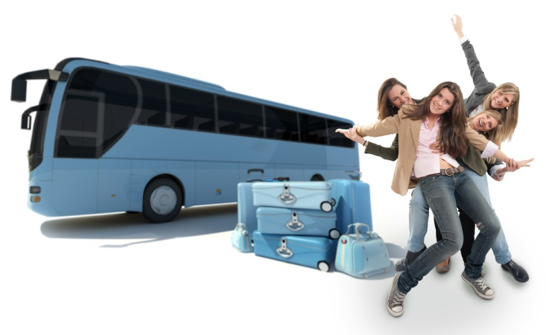
3.1 Provide tour details to support staff
The itinerary is list, description of all the travel arrangements services involved and will include:
Tour duration
Transport
Transfers and connections
Accommodation and Meals
Inclusions and options
Notes:
Trainer to stress that the itinerary must be explained in detail to the tour staff so they can deliver the tour in the most efficient way possible
Tour staff needs to pay special attention to the tour schedule, timetable, transfer times, visits times, accommodation and meals times and requirements
They also need to be familiar with all inclusions and options as they will be managing them

Slide 41
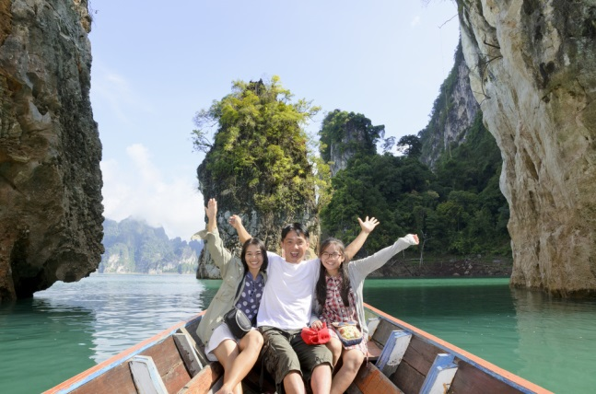
3.1 Provide tour details to support staff
The group profile is a collation of information from the tour group members that will give the tour staff an understanding of the type of customers on the tour .The information might include:
Number of participants
Origin
Age bracket
Special needs, requests
Language spoken
Main interest
Potential identified problems customers
Notes:
Trainer to remind trainees that good customer service is one of the keys element to deliver a successful tour
Knowing your audience will help with ensuring you meet the group tour members expectations
Case study : during the tour briefing it emerges that a large majority of the overnight indulgence, luxury tour participants are not fluent in English. In pairs, decide what steps, strategies you will put in place to ensure the success of the tour

Slide 42
3.1 Provide tour details to support staff
It is an important requirement for the staff to have all the documentation necessary to successfully manage the tour. The documentation might include:
Rooming lists
Running sheet
Daily log
Notes:
Trainer to explain to the trainees what is a :
Rooming list
Running sheet
Daily log
and why those documents are important

Slide 43

3.1 Provide tour details to support staff
It is an important requirement for the staff to have all the documentation necessary to successfully manage the tour. The documentation might include:
Information and forms to forward to the organisation such as:
Invoices
Payment receipts
Notes:
Trainer to remind the trainees that the administration side of any tour is important as it serves to keep transaction records that will be used for
Accounting purposes
For future reference

Slide 44

3.2 Provide resources to support tour
Resources are indispensable to support a tour and can include:
Documentation:
Official documentation such as visa, entry permits, licenses , company policies
Letter of authority
Tour group members specific medical details
Vouchers, tickets
Tour schedule, detailed timetable , maps
Industry contacts names and contact numbers
Notes:
Trainer to go through what resources to support tour can cover :
Documentation as listed above
Industry contacts

Slide 45
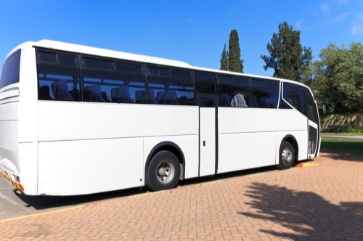
3.2 Provide resources to support tour
Resources are indispensable to support a tour and can include:
Physical resources:
Vehicles
Supplies and equipment:
Food supplies
Phones
DVD
Speakers, music
Notes:
Trainer to go through the list and remind trainees that different tours will have different resources requirements
Trainees to complete some research and put together a physical resources list for a 2 nights bush camping tour and share their findings with the class when the list is completed

Slide 46

Element 4: Liaise with external industry colleagues throughout the tour
Liaise with industry personnel to facilitate tour implementation
Request assistance, when appropriate
Make on tour agreements with organisations to respond to issues arising
Notes:
Trainer to explain that this 4th element is about liaising with all external colleagues, suppliers

Slide 47

4.1 Liaise with industry personnel to facilitate tour implementation
A good relationship and positive dialogue is crucial between the staff tour and all industry personnel involved and might involve:
Enquiring about a specific topic, request
Confirm all details required to deliver the products and service
Forward bookings
Make sure all the information shared is clear, easy to understand.
Notes:
Trainer to use the examples from the workbook or his/her examples to illustrate the points on the slide
Trainer to ask trainees to explain, in your own words, the importance of liaising with industry personnel using an example

Slide 48

4.2 Request assistance, where appropriate
Specialist advice might be required at some point in time:
Advice, recommendations, suggestions
Negotiating changes
Notes:
Again, using the workbook examples or others, the trainer will explain how specialist advice might be required during the tour and changes negotiated, if required
Class activity : trainees to find examples when legal advice due to change

Slide 49

4.3 Make on tour arrangements with organisations to respond to issues arising
What is an issue?
Different issues demand different arrangements:
Re-negotiation of contractual agreements
New contractual agreements
Notes:
Trainer to brainstorm with the trainees examples of issues that might arise during a tour
Trainer to explain the difference between issue and emergency
Trainer to explain, as per the workbook examples, what measures can be put in place to respond to issues arising from organising transport to change a booking

Slide 50

Element 5: Manage on tour itinerary
Facilitate conduct of the tour schedule
Advise tour staff regarding issues arising
Re-plan itinerary as required
Maintain contact with those responsible for those responsible for resolving on tour issues
Advise industry colleagues regarding tour changes
Monitor the tour area
Notes:
Trainer to go through the 6 criteria and insist we are now dealing with the management of the tour itinerary

Slide 51

5.1 Facilitate conduct of the tour schedule
The facilitation can take place in various forms:
Office based assistance
Communication and information management
Notes:
Trainer to explain the importance of the tour schedule and keeping to it to make sure all the activities, options etc can take place on time and when scheduled
The facilitation can be provided both by the office and on the ground by the tour staff dealing with all products and services suppliers, support systems such as emergency numbers if required

Slide 52

5.1 Facilitate conduct of the tour schedule
The facilitation can take place in various forms:
Office based assistance:
Inclusion of all features
Adherence to schedule
Complaints resolution
Notes:
Trainer to provide the trainees with some tour organisations contact name and number. Trainees to find the type of office based support the organisation provide to the tour staff while on tour. Findings to be shared with the class when the activity is completed and compared with the items listed in the workbook

Slide 53

5.1 Facilitate conduct of the tour schedule
The facilitation can take place in various forms:
Communication and information management:
Acting on behalf of tour leaders/guides
Supplying requested information
Making payments if required
Notes:
Trainer to explain how those points are also designed to support the staff while on tour and illustrate the points with a few examples from the region, country

Slide 54

5.2 Advise tour staff regarding issues arising
Tour staff must be informed of any issues arising as soon as possible.
Depending on the tour location, the host enterprise, office might be aware of issues arising before the tour staff.
Notes:
Trainer to conduct internet research with trainees within their country to identify specific locations where the situation explained on the slide would take place due to remote location and difficulty in communication

Slide 55

5.2 Advise tour staff regarding issues arising
The most efficient way to deal with the situation is to:
Deal with issue from the office
Brief the tour staff of:
Issue
Proposed or organised action
Notes:
Trainer to comment on the examples in the workbooks or use his /her own to illustrate the point

Slide 56
5.2 Advise tour staff regarding issues arising
Briefing information must be:
Clear
Precise
Notes:
Trainer to comment on slide and also remind trainees about the well being of tour group members being more important than financial considerations

Slide 57

5.3 Re-plan itinerary as required
The issues to consider are :
On the ground response
Legislation and liabilities
Confirmation and communication
Customer service
Notes:
Trainer to explain that re planning an itinerary is going to require team work and all 4 points listed need to be carefully considered

Slide 58

5.3 Re-plan itinerary as required
On the ground response involves:
Tour group members and tour staff
Suppliers, providers of products and services
Notes:
Trainer to explain the consequences of re-planning itinerary using workbook examples or his/her own.
Trainer to stress the importance of putting the tour group members first

Slide 59

5.3 Re-plan itinerary as required
Legislation and liabilities:
Importance of being compliant not only with host enterprise country legislation and liabilities
And where the tour is taking place
Notes:
Trainer to explain the differences between countries legislation, liabilities, duty of care etc.
Class activity : trainees to find the relevant country legislation , guidelines or even examples in regards to tour operator liabilities when a change of itinerary takes place

Slide 60
5.3 Re-plan itinerary as required
Confirmation and communication:
All alternative arrangements must be confirmed
Notes:
Trainer to discuss with trainees the various ways alternative arrangements can be confirmed and communicated to all concerned parties nowadays

Slide 61
5.3 Re-plan itinerary as required
Customer service:
How to minimise disruption to tour group members
Notes:
Trainer to illustrate the point by asking the trainees in groups of 4 to write a scenario about a change of itinerary due to a road closure.
Trainees to role play what the tour staff would say to the tour group members to minimise disruption and dissatisfaction

Slide 62

5.4 Maintain contact with those responsible for resolving on tour issues
Several parties will be involved in resolving tour issues and a clear strategy needs to be implemented including the following steps:
Central contact point
Progress report
Financial settlement
Notes:
Trainer to split the class into 3 groups. Groups to read the workbook content and then explain it to the rest of the class
One group will cover central contact point
One group progress report
One group financial settlement

Slide 63
5.5 Advise industry colleagues regarding tour changes
Any change, issue will have a flow on effect and some changes might have to be communicated to the products and service suppliers such as:
Transport
Accommodation and catering
Venues
Notes:
Trainer to illustrate the slide content with the workbook examples or his/her own

Slide 64
5.6 Maintain regular contact with group
Why?
To ensure the tour is running according to plan, schedule and in a safe manner
Notes:
Trainer to remind trainees of the importance of the support role the host enterprise needs to plan when managing on tour itinerary

Slide 65

5.6 Maintain regular contact with group
How?
Establish most efficient method of contact
Have all correct contacts names, details available at all times
Establish regular contact schedule
Notes:
Trainer to explain this follows onto the importance of keeping in touch and ensuring that, even if the tour is in a remote location, regular contact can be made and maintained

Slide 66

5.7 Monitor the tour area
Why?
Again, to ensure that, as much as possible, the tour is free of problems and risks
Notes:
Trainer to remind trainees of the host enterprise legal responsibilities and duty of care

Slide 67

5.7 Monitor the tour area
How?
Monitor countries, regions scheduled on the itinerary on a regular basis
Consult dedicated websites such as official government ones
Maintain industry contacts
Notes:
Trainer to illustrate the points on slide by researching with trainees official websites such as Smart traveller in Australia
www.smartraveller.gov.au/

Slide 68

Element 6 Deal with unexpected events
Initiate contingency planning actions
Support tour group leaders/guides
Research and suggest additional action to be taken
Make arrangements in response to identified emergencies
Notes:
Trainer to introduce this element dealing with unexpected events and their impact on the tour
Trainer to detail the 6 performance criteria

Slide 69

Element 6: Deal with unexpected events
Handle media interest
Amend tour itinerary as required
Notes:
Trainer to introduce this element dealing with unexpected events and their impact on the tour
Trainer to detail the 6 performance criteria

Slide 70
6.1 Initiate contingency planning actions
An efficient organisation and its staff need to be prepared for unexpected events that can impact on the tour delivery. They must be managed in order to minimise disruption to tour group members.
Notes:
Trainer to remind the trainees of the importance of knowing what to do when the unexpected happens and stress the organisation’s responsibilities in having a EMP (Emergency Management Plan) and making sure all tour staff are familiar with it

Slide 71

6.1 Initiate contingency planning actions
Unexpected events that can impact on the tour delivery can be:
Traffic accident
Airline strike
Venue suddenly unavailable
Medical emergency
Natural disaster
Notes:
Trainer to explain this list is not exhaustive and ask trainees for other examples

Slide 72

6.1 Initiate contingency planning actions
Contingency plans must be actioned according to the following sequence:
Identify the most appropriate contingency plan
Proceed with plan if appropriate, if not modify plan
If required, possible and applicable, organise third party support
Make it happen
Notes:
Trainer to detail each step and options to make sure the contingency planning actions are the best for dealing with the unexpected event

Slide 73

6.2 Support tour leaders/guides
The support can be provided in different manners depending on the type of unexpected events and the tour location:
Communication: suggestions and dialogue
On the ground support
Notes:
Trainer to insist on the importance of the 2 topics , one being more office based and the other one on the ground support

Slide 74

6.2 Support tour leaders/guides
The support is essential to deal with any unexpected event in a quick and efficient manner:
Communication: suggestions and dialogue:
Engage in open dialogue to make sure all parties can express their own suggestion
Notes:
Trainer to stress how important it is to listen to all parties as they might come from difference perspective and offer different strategies to deal with the unexpected event. The office based staff might have had more time to do research as the staff on the ground

Slide 75

6.2 Support tour leaders/guides
The support is essential to deal with any unexpected event in a quick and efficient manner:
On the ground support:
Decision might be taken to send dedicated staff members to support the staff on the ground
Notes:
Trainer to go over the examples in the workbook and explain the difference between a
Crisis management team
Designated business representative
Trainer to ask the trainees to write, in their own words, how sending staff on the ground will provide moral support

Slide 76

6. 3 Research and suggest additional action to be taken
Additional information might be a way of supporting the staff and can be gathered:
Via internet, social media to get the very latest information
Using all available contacts and authorities:
Local authorities
Local agencies
Local networks and contact
Notes:
Trainer to explain that ‘knowledge is power’ and one of the best outcome of data gathering is to find and get in touch with parties, people who have gone trough the same unexpected even and discuss : what happened-what was one and how and use the information and experience

Slide 77

6.4 Make arrangements in response to identified emergencies
There are many types of emergencies that may arise during a tour, and an emergency might result in a significant disruption or even the cancellation of the tour.
Protocols for individual businesses will vary in respect of their procedures for providing support during an emergency and may include.
Notes:
Trainer to have a brainstorming session with trainees and list as many emergencies as possible on the board or flip chart

Slide 78

6.4 Make arrangements in response to identified emergencies
Tour changes ranging from a tour change ranging from:
A change in the schedule
A change of accommodation, restaurant
An alternative venue, option
Notes:
Trainer to explain that any change needs to be take place with the minimum disruption for the tour group members
Trainer to direct the trainees to do complete research on how various organisations dealt with the Iceland volcano eruption situation in April 2009 when 100,00 planes were grounded and 10 millions passengers stranded at some point in time and their travel plans disrupted . Findings to be shared with the class

Slide 79

6.4 Make arrangements in response to identified emergencies
Cancelling tour will be a decision taken as a ‘last resort’ after all other avenue have been explored and will involve:
Repatriation
Liaising with suppliers(if possible) to cancel the products and services booked
Notes:
Trainer to insist on the fact that a tour that has already started will be cancel only as a last resort.
Discuss the points on slide with trainees
Discuss the possible flow on effect in regards to the host enterprise, tour operator reputation

Slide 80

6.4 Make arrangements in response to identified emergencies
When managing an emergency, communication with tour group members families needs to:
Take place on a regular basis
Be timely so the families DO NOT hear the latest news via the media
Families must be dealt with respect, dignity and sensitivity
Notes:
Trainer to impart on the trainees the importance of this public relation aspect of an emergency.

Slide 81

6.5 Handle media interest
When the media becomes involved, the organisation needs to:
Nominate one person to be act as the liaison between the organisation and the media
Ensure the information they issue is truthful and accurate
Notes:
Trainer to explain each organisation should have a protocol in place for those times when the media will become involved
Trainer and trainees to do some research and/or use recent publicised tour unexpected events and discuss how each company, organisation dealt with the media attention from printed media to Facebook and twitter

Slide 82
6.6 Amend tour itinerary as required
The recommended procedure was covered under element 5 and include considering the following issues:
On the ground response
Legislation and liabilities
Confirmation and communication
Customer service
Notes:
Trainer to use this as revision from 5.3

Slide 83

Element 7: Finalise the tour
Solicit feedback from tour group members
Solicit feedback from suppliers, providers and carriers
Debrief tour staff
Prepare report
Share information with suppliers, providers and carriers
Archive information for future reference
Notes:
Trainer to explain this is the last element of the unit and it covers the tasks to complete after the tour completion
This element has 6 topics (criteria)

Slide 84


7.1 Solicit feedback from tour group members
Why?
How?
Notes:
Trainer to explain the importance of feedback from all concerned parties. Feedback enables any organisation to know how the are doing with customers and criticism should be seen as an opportunity to improve
Trainees to research the various ways feedback can be obtained and share with the class

Slide 85
7.2 Solicit feedback from suppliers, providers and carriers
How?
Why?
Notes:
Trainer to explain that the industry colleagues you work with can also provide useful feedback on your tours, business and potential ways to improve the way you conduct your business, identify trends and your relationship with them
How you obtain can be similar to soliciting feedback from tour group members : verbal, written, questionnaires, web based feedback
Trainees to work in pairs and pretend they are a product or service supplier for a large tour operator: what would they expect from the company so the business relationship is viable and strong? All findings to be shared and discussed further

Slide 86

7.3 Debrief tour staff
Debriefing is an important component of continuous improvement and quality control. The debriefing needs to take place soon after the tour completion and cover the following:
How did the tour go?
What worked and did not work
Problems encountered and how they were dealt with
What products and services to included for the next tour
Notes:
Trainer to cover the various aspects to cover to support the organisation continuous improvement and quality control
What worked and did. If any problem/s, what happened and how was it handled/were they handled?
This is the first stage of the debrief

Slide 87

7.3 Debrief tour staff
Debriefing is an important component of continuous improvement and quality control. The debriefing needs to take place soon after the tour completion and cover the following:
Quality control checks in regards to:
Timetable respected?
Products and services matching expected standards
Notes:
The second stage deals with quality control components such as
Was the timetable followed?
Was the delivery of services matching the products and services standards?

Slide 88

7.3 Debrief tour staff
Debriefing is an important component of continuous improvement and quality control. The debriefing needs to take place soon after the tour completion and cover the following:
Potential changes covering:
Policies and procedures
Timeline for confirmation of final numbers to all suppliers
Schedule: too tight?
continued
Notes:
Last stage:
Potential changes : trainer to explain the debrief is an opportunity to get the tour staff feedback ‘first hand’ as they are on the ground and experience first hand what works or not

Slide 89

7.3 Debrief tour staff
Potential changes covering:
Number of activities
Timing of the activities: time of day, day of the week
Equipment used
Tour group members feedback
Notes:
Trainer to explain the more feedback, the better
Class activity : trainees to do some research via phone, internet, or even using the trainer’s industry connections to find out :
1 or 2 organisations Standard Operating Procedures in regards to the timeline between a tour completion and the tour staff debrief
Trainees to share their findings with the rest of the class when they have gathered the information

Slide 90

7.4 Prepare tour report
The tour report is a summary of the what happened during the tour and should include thoughts and ideas for modifications and improvements.
It can be delivered in a written format, set template, written for, or verbal report.
Notes:
Trainer to clarify that the tour report is indeed a summary of what happened during the tour and , in most organisations, is simply the extension
of the debrief
Trainees to research on the internet templates that could be used for a tour report and present them to the class explaining their choice

Slide 91

7.4 Prepare tour report
It will cover:
Itinerary
Transport
Activities
Commentary
continued
Notes:
Trainer to ask each trainee to list one topic, item that can be part of the tour report and write it on board

Slide 92

7.4 Prepare tour report
Delays
Problems
Complaints
Feedback
BOTH negative and positive aspects of the tour
Notes:
Trainer to ask each trainee to list one topic, item that can be part of the tour report and write it on board
Once the list is completed, trainees to research on the internet templates that could be used for a tour report and present them to the class explaining their choice

Slide 93

7.5 Share information with suppliers, providers and carriers
The shared information will comes from different sources:
Group tour members’ feedback
Tour debrief
Tour report
Notes:
Trainer to insist on the importance of sharing all the information obtained as part of the debrief/report with all the industry partners having provided products, services to the tour and also remind trainees the information needs to be qualitative and quantitative(sales numbers etc..)
Trainees to work in groups of 3 or 4 and write
1 advantage in sharing the information with suppliers, providers and carriers
1 disadvantage in sharing the information with suppliers, providers and carriers

Slide 94

7. 6 Archive information for future reference
All documentation must be filed and archived as per the organisation and management requirements. The system can be:
Filing cabinet
Drawer system
Electronic filing
Notes:
Trainer to explain that the archiving system will be different from one organisation to the other, stressing that nowadays electronic filing is become prevalent

Slide 95

7. 6 Archive information for future reference
All documentation must be filed and archived as per the organisation and management requirements. The system can be:
Future reference
How long for?
Notes:
Trainer to discuss with the trainees why is important is to make sure the information will be easy to access for future reference
Lastly , explain to the trainees that every organisation needs to follow the law or regulations in regards to how long official documents need to be kept for. This varies depending on the country.

